Slide 1
Senior Fun Hub
Team 1 – Luis Hernandez, Matthew Satterfield, Kodiak Shepard, Rebecca Tester

Slide 2
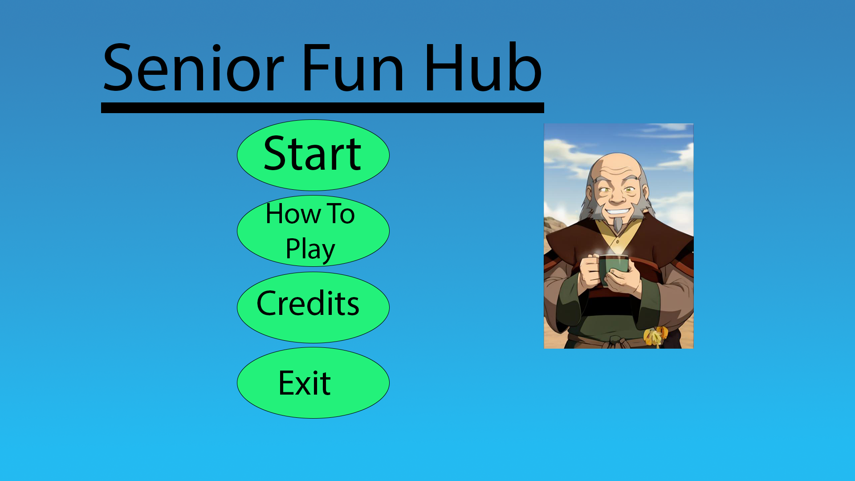
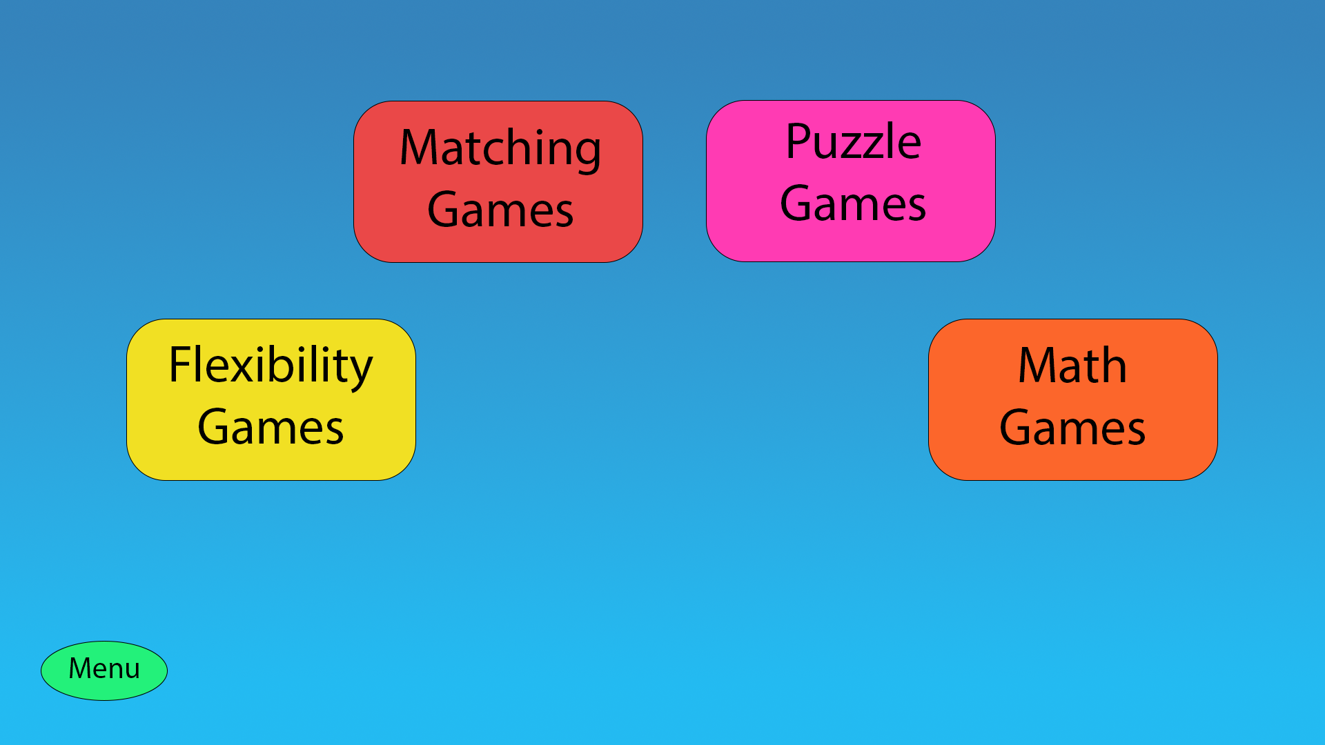
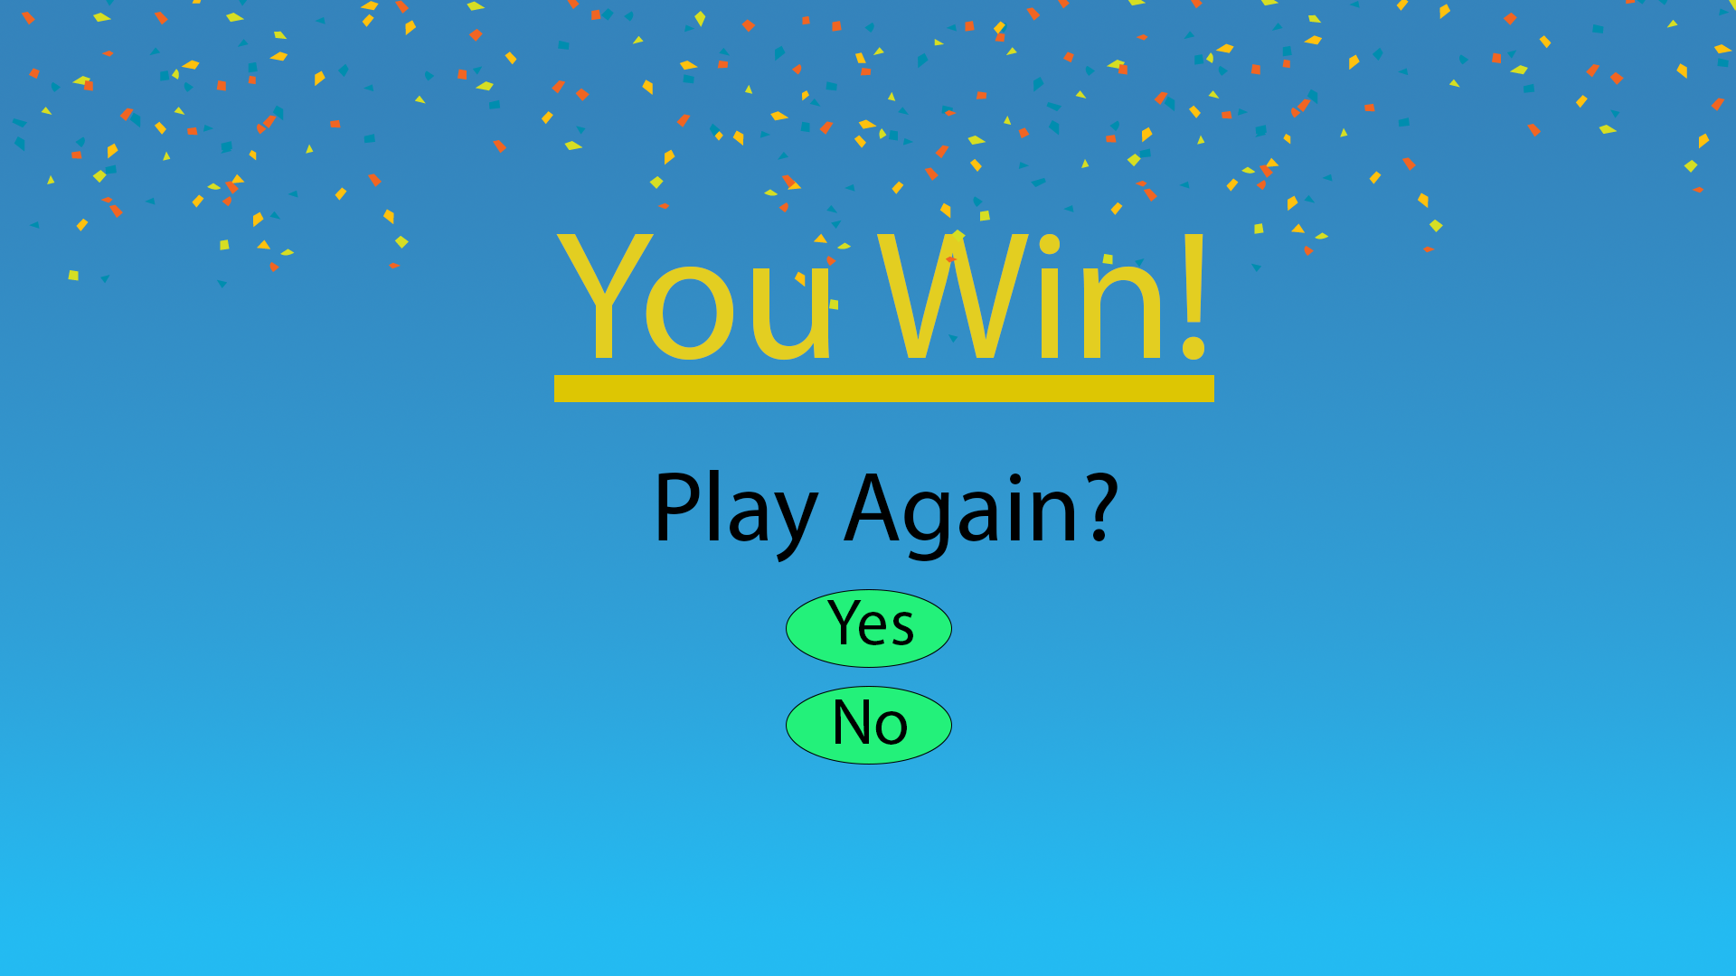
Placeholder Menus
Main Menu
Hub
Win Screen

Slide 3

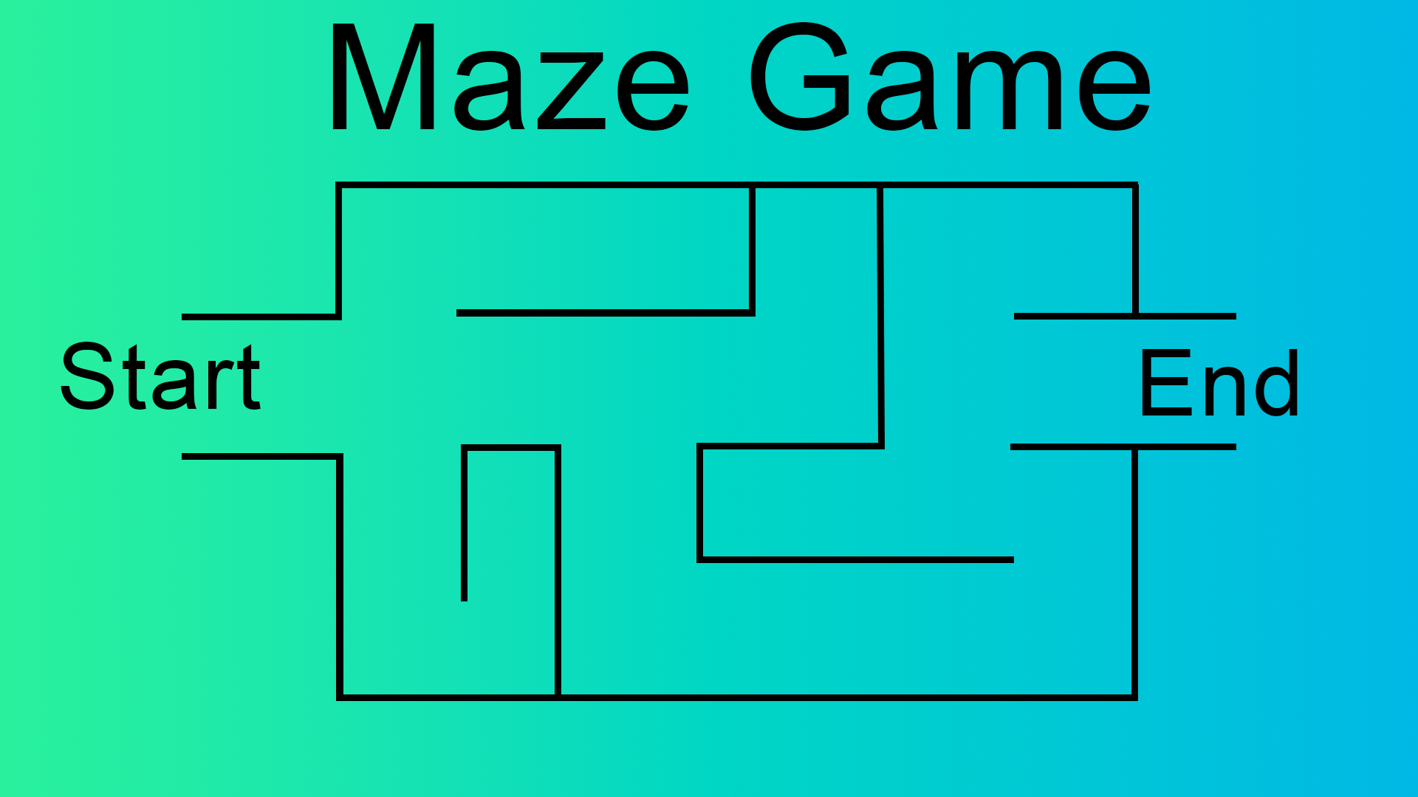
Maze game placeholder art

Slide 4
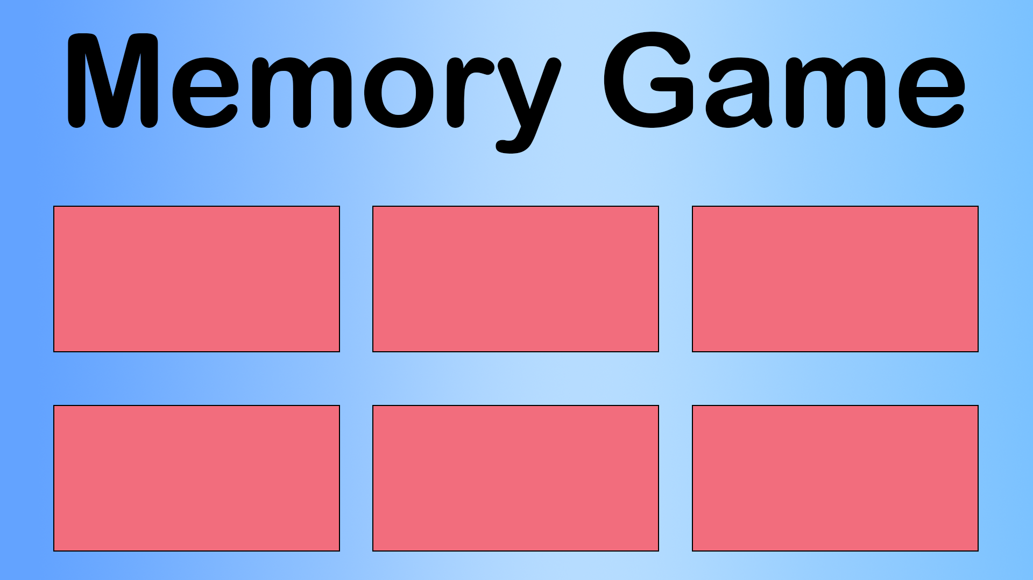


Memory game placeholder art

Slide 5
Meeting Needs
To meet the needs of our demographic we used:
Mouse Only
Large Buttons and Text
Variety of Contrasting Colors

Slide 6
Thank You For Listening!
Any Questions?

Slide 7
Let's play!

